Slide 1

Dollar Tree
[NASDAQ: DLTR]
Stock Rating: HOLD
Industry View: Retail
Price Target: 79.25
Price (as of 12/5):
Potential Upside: 8.44%
Market Cap: 15.6B
Shares Outstanding: 220M

Slide 2

Table of Contents
01
02
03
Business overview
Competitive Analysis
Conclusion
04
05
Recommendation
Appendix
Dollar Tree

Slide 3
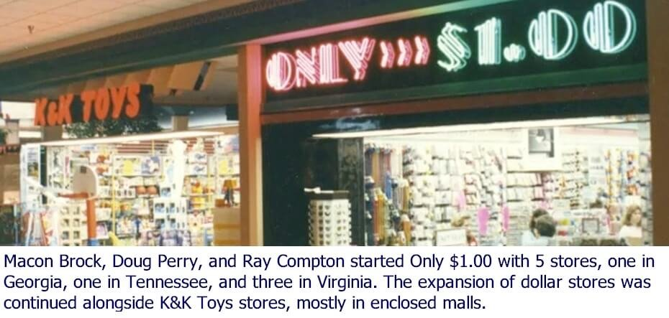





Company History
Discount Variety Store
1956
K&K 5&10
“Only $1.00”
1986
CEO
1989
First Store
Michael C. Creedon Jr.
Stores
Went Public
On Nasdaq
1995
16,774
2015
Acquired Family Dollar
Dollar Tree

Slide 4
Industry
Dollar Tree
Notes:
$124.9 Billion Revenue
$5.5 Billion Profit
4.4% Profit Margin

Slide 5
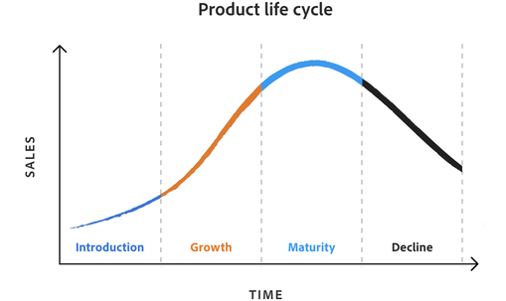
Life Cycle of Dollar Tree: Mature
DLTR EBIT, EBITDA, Gross Profit Margin
Dollar Tree

Slide 6
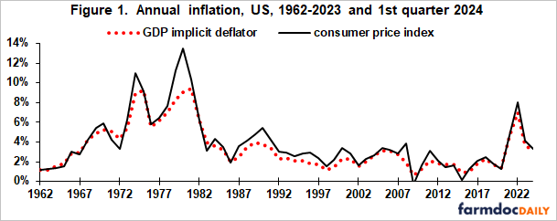
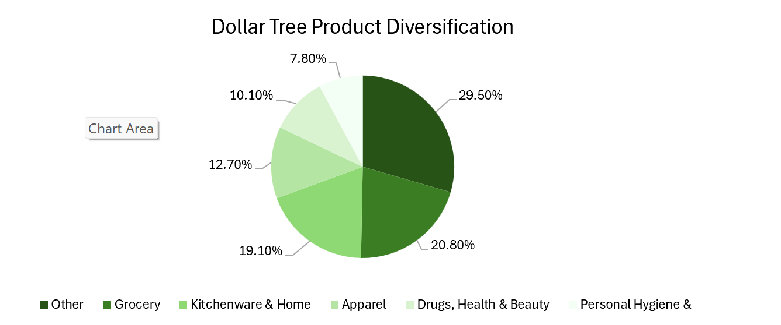

Macro Trends
Inflation
Supply Chain
Product Offerings
Dollar Tree

Slide 7
How is Dollar Tree positioned within these trends?
Inflation
Supply Chain
Product Offering
As mentioned, the price hike
Brought in an 8.6% increase in
revenue, and a 1.3% increase in
gross profit margin
Although hard to mitigate, the supply chain is set to stabilize within the next couple year
The new pricing allows Dollar Tree to introduce new product to their stores
As for Dollar Tree, some proactive measures would negotiate prices with suppliers, strengthen available stock, and even seek new distributors
Having a wider range of products allows for more customers and thus a higher customer loyalty rate
Appeal to cost-conscious customers, as prices are still much lower than other retailers
Dollar Tree

Slide 8
Historical Growth
As seen in the chart Dollar Tree has strong Revenue growth
and is expected to keep inhibiting this growth as 2023 numbers suggest.
The growth is fueled by the strong business model, which emphasizes
affordability and a diverse product offering
And with the 25% price hike, we have seen the jump in revenue from 2022 to 2023 to be stronger than the preceding years
With Dollar Tree Plus! being integrated into new stores it provides new products to an already product dense product selection further increases customer traffic and thus revenue
Dollar Tree

Slide 9
Table of Contents
01
02
03
Business overview
Competitive Analysis
Conclusion
04
05
Recommendation
Appendix
Dollar Tree

Slide 10




Key Players
Dollar Tree
Notes:
In the variety store landscape, Dollar Tree faces stiff competition from key players like Dollar General, Costco, Walmart, and Target. Dollar General is their main competitor as they also target the same value-oriented group of customers seeking low prices. Costco, Walmart, and Target aren't typical discount stores, but still massive retailers with large product offerings, discounts, and memberships, giving them an advantage in the market.

Slide 11
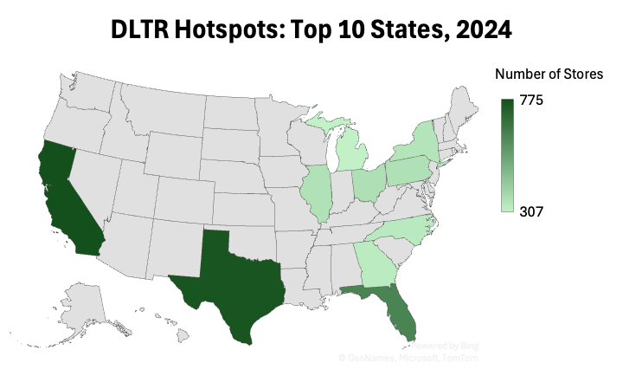
SWOT Analysis: Internal Factors
Strengths | Weaknesses
Brand recognition & market access Multiple price-point initiative Company growth with 99 Cents Only Stores acquisition | Decreased operating income margins due to higher expenses Underperformance of Family Dollar segment Changes in leadership
Dollar Tree
Notes:
Dollar Tree has a robust market presence with over 16,000 stores in the 48 states and 5 canadian provinces, making it far more accesible tham its competitors. And uses its rolled out their new multi-pice-point initiative which has added a new variety of products costing to $5 to increase their store traffic keeping it well below )the Targets, Walmarts, and Costcos in every region.which has grown by 2.1%.
Expanding the company's reach in key states strategic acquisitions like (170 locations of) of the recent 99 Cents Only Stores, expanding the company's reach in key states (California and Texas, ).
As per their weaknesses, Facing challenges, including declining operating income margins due to higher (SalesGeneral&Administrativ) energy and transport costs (up 200 basis points bc of) ( higher depreciation expense, increased energy costs, freight transportation costs) and Family Dollar’s underperformance, with sales dropping 4% in the last three months. Recently, theres been a number of Leadership changes, including their long time CEO stepping down due to health issues, who had a major role in reviving the business which is bound to create some operational instability in the short term

Slide 12
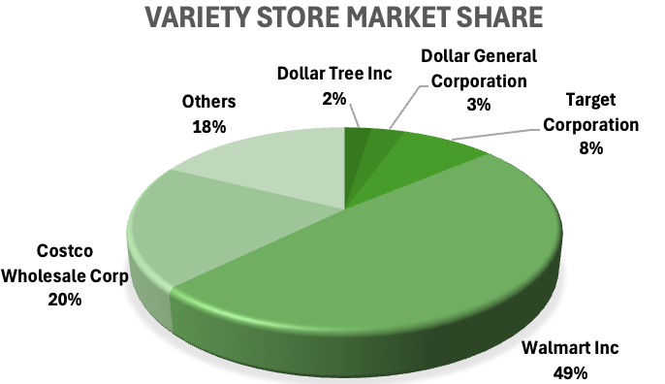
SWOT Analysis: External Factors
Opportunities | Threats
Portfolio Optimization Increased Product Assortment International Expansion | Highly Competitive Market Reduced Consumer Purchasing Power Supply Chain Vulnerabilities
Dollar Tree
Notes:
Dollar Tree is optimizing its portfolio, closing nearly 700 underperforming Family Dollar stores to either spin off these locations or divest to generate value. It’s also expanding the previously mentioned multi-price point lines to more stores beyond the 10% they have already trialed at to enhance transaction values towards more customers. Further expansion, internationally, especially into regions with developing economies like Brazil or Southeast Asia, to tap into value-conscious populations.
Intense competition from Walmart, Dollar General, and others continuously pressures DLTR's market share. Economic challenges, including inflation has impacted Low-income households, who tend to shop at deep discounters, and a slough of supply chain disruptions caused by severe and unprecedent weather events like the Oklahoma recent tornado causing losses of $117 million by hitting their distribution center threaten margins and inventory stability.

Slide 13
Porter’s 5 Forces
Degree of Rivalry
HIGH
Threat of New Entrants
MODERATE
Threat of Substitutes
MODERATE
Competitive discount retail market
Brand Loyalty and Customer Switching
Low Barriers to Entry in Discount Retail
Regulatory Hurdles as Protective Barriers
35k+ Competing Discount Store
Local Low-Cost Alternatives
Dollar Tree
Notes:
Threat of Sub:
16,300 Competing Discount Stores: Over 16,300 competing discount retail stores provide alternative shopping options, intensifying the competition.
Rise of E-Commerce: The projected growth of e-commerce to exceed $1.5 trillion in sales by 2025 poses a significant threat, as online retailers offer convenience, delivery services, and competitive pricing.
Local Low-Cost Alternatives: Local dollar stores and thrift shops in urban and suburban markets offer even lower average prices, increasing the attractiveness of substitutes, especially during economic downturns.

Slide 14
Porter’s 5 Forces
Suppliers Power
HIGH
Customers Power
HIGH
Limited Supplier Base Increases Bargaining Power
Challenges from Supplier Consolidation
Intense competition in the retail market
Price Sensitivity of Core Demographic
Shift towards online shopping
Dollar Tree

Slide 15
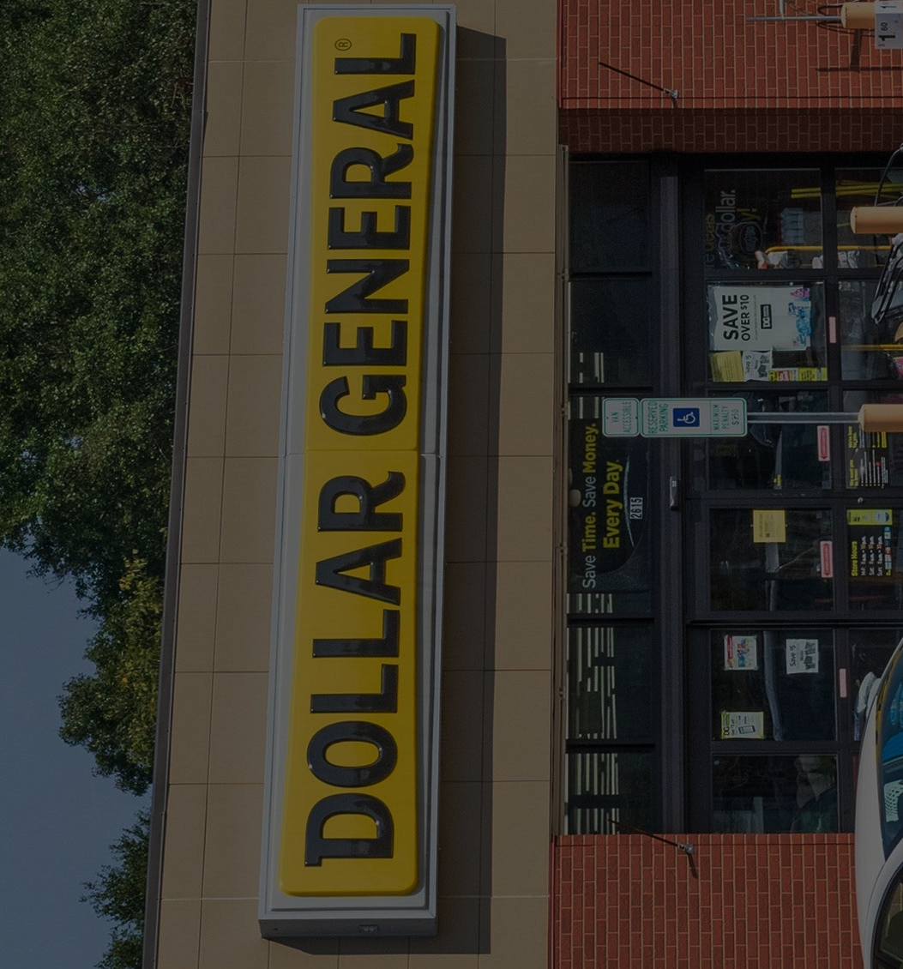
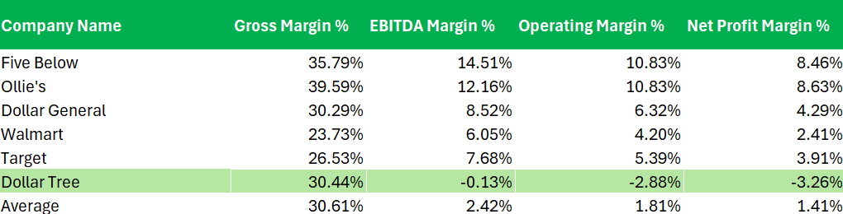
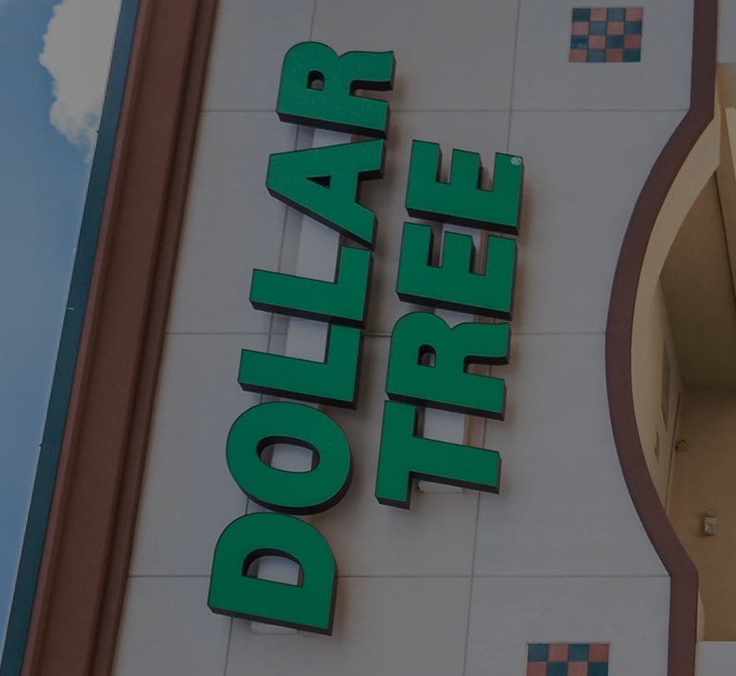
Margins Relative to Competition / Pricing Power
Margins Relative to Competition
Pricing Power
Below average profitability
Competitive Gross Margin
Challenges in Profit Sustainability
Tiered pricing strategy
price-sensitive customer base
Dollar Tree

Slide 16
Table of Contents
01
02
03
Business overview
Competitive Analysis
Conclusion
04
05
Recommendation
Appendix
Dollar Tree

Slide 17
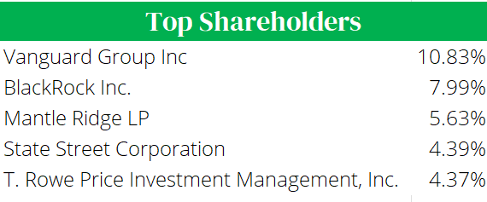
Major Shareholders
3.49% of shares held by Insiders
96.51 % of shares held by Institutions
Dollar Tree

Slide 18
Composition of Revenues
40%
Dollar Tree

Slide 19
DuPont Analysis
ROE:
-13.75 x
Asset Turnover: 1.35 x
Profit Margin: -4.94 x
Financial Leverage: 2.06 x

Slide 20
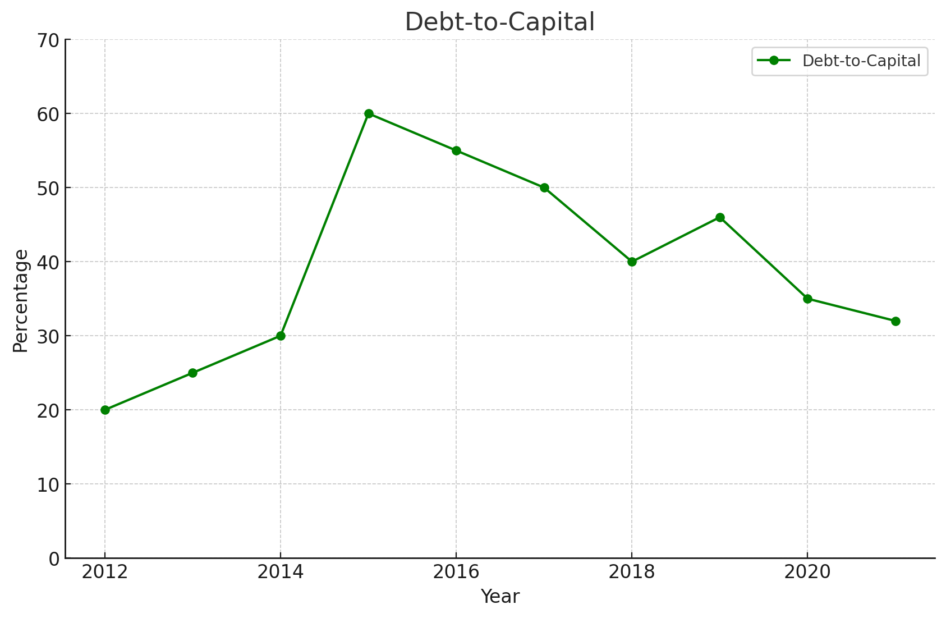
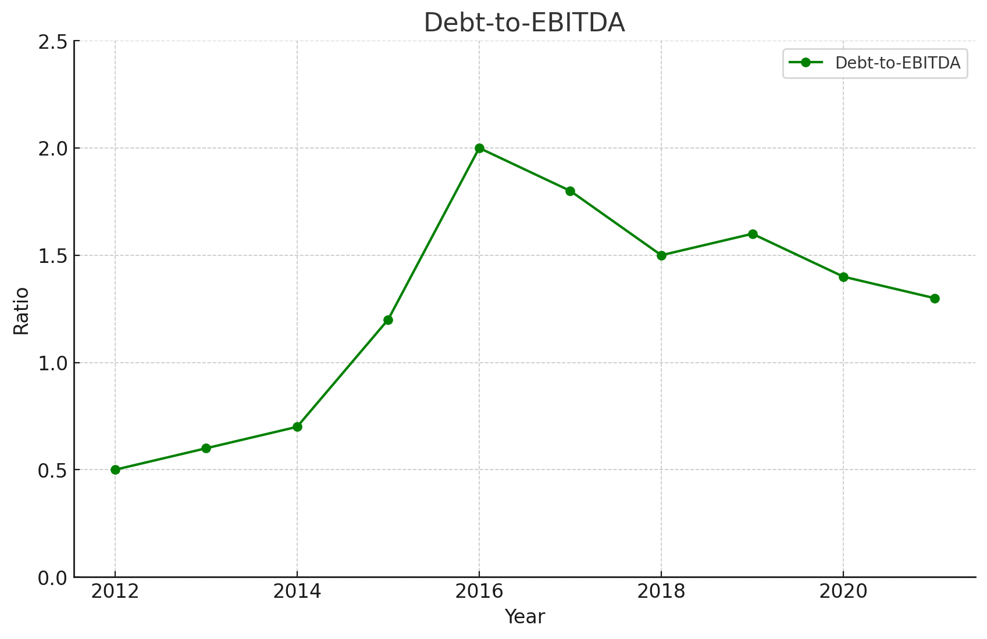
Leverage / Capital Structure
Debt-to-Capital is 32%
Debt-to-EBITDA is 2.23x

Slide 21
Working Capital Structure
Cash Conversion Cycle: 57.4 Days
Days Sales Outstanding: 1.5 Days
Days Inventory Outstanding: 90.62 Days
Days Payable Outstanding: 35.38 Days
Dollar Tree

Slide 22
Assumptions
Revenue Growth: 7.6%
EBITDA Margin 10.6%
Weighted Average Cost of Capital 6.07%
D&A as a % of Revenue 11.2%
COGS as % of Sales 4.3%
Capex as a % of Revenue 4.8%
Dollar Tree

Slide 23
Target Price vs Trading Price
Dollar Tree’s fair share price is
$81.87
$72.56
$81.87
+8.44% Upside
40%

Slide 24
Table of Contents
01
02
03
Business overview
Competitive Analysis
Conclusion
04
05
Recommendation
Appendix
Dollar Tree

Slide 25


Risks and Mitigants
Workforce and Operational Challenges
Mitigant: Enhance retention with better pay and training, automate tasks to cut costs, and use analytics to prevent supply chain disruptions.
Tariffs
Mitigant: Dollar Tree can mitigate tariff risks by diversifying suppliers and expanding private products to protect margins. CEO and CFO changes underscore a renewed focus on cost stabilization and strategic adaptation.
40%
Dollar Tree

Slide 26
Recommendation
Digital Innovation and Omni-Channel Capabilities
Rapid Expansion & Growth
Leadership Changes
Dollar Tree

Slide 27
Table of Contents
01
02
03
Business overview
Competitive Analysis
Conclusion
04
05
Recommendation
Appendix
Dollar Tree

Slide 28
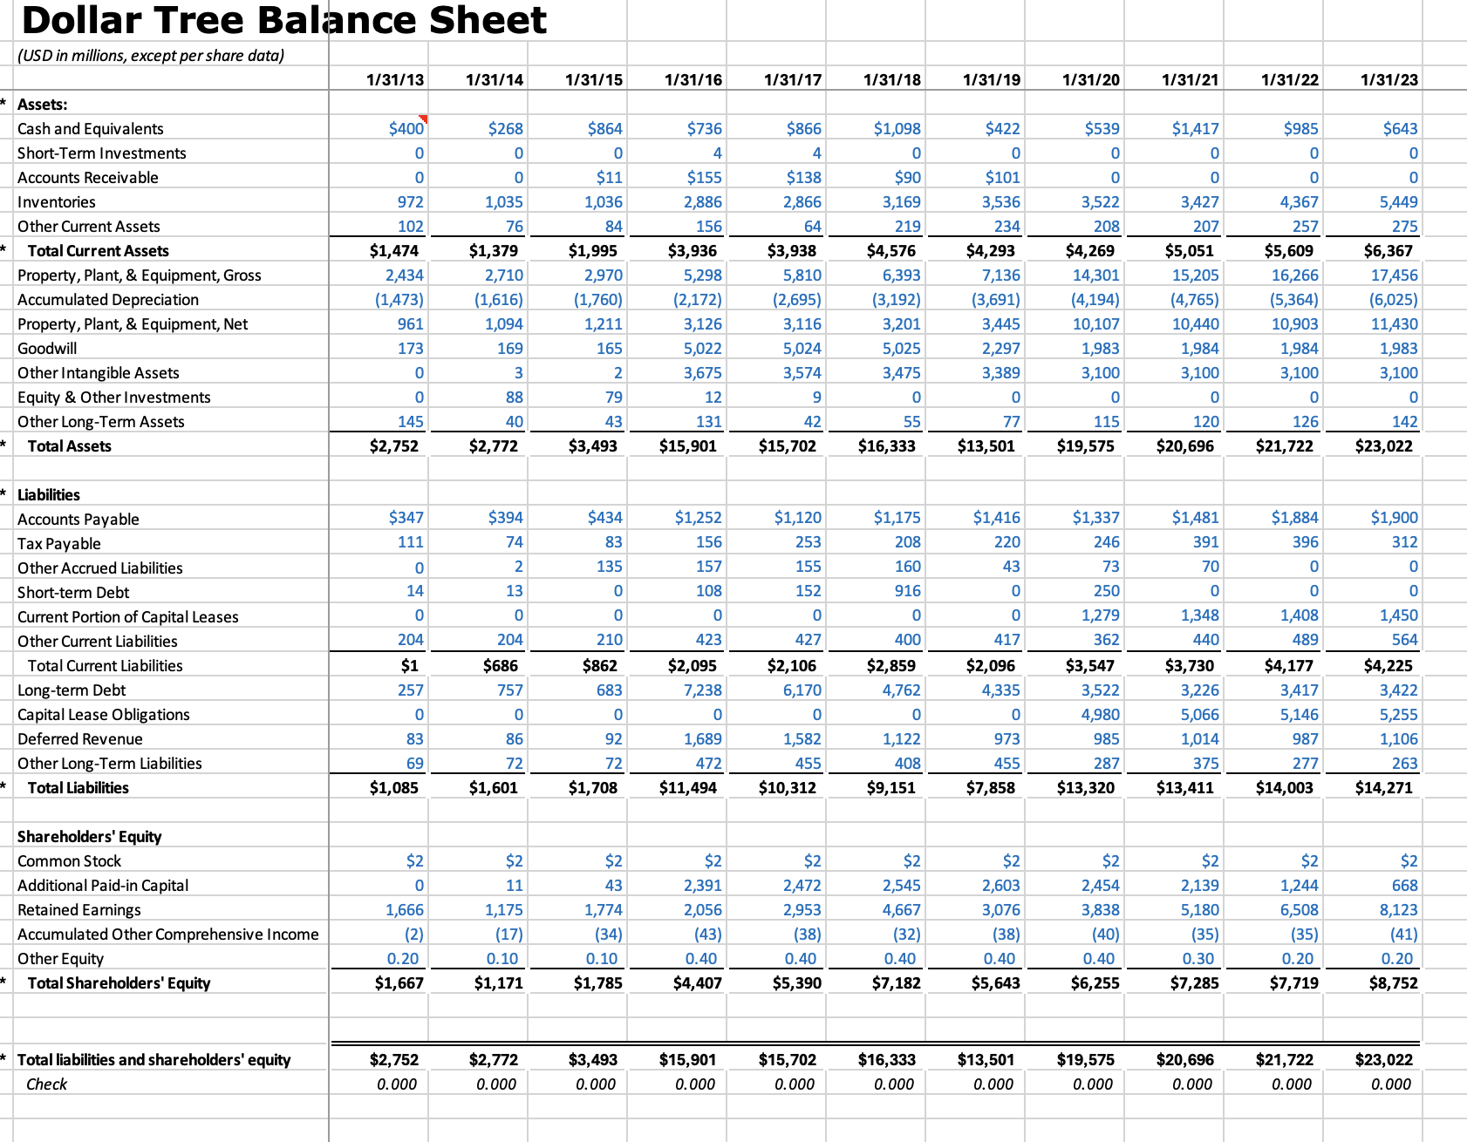
Appendix A: Balance Sheet
Pluto is a dwarf planet
Dollar Tree

Slide 29
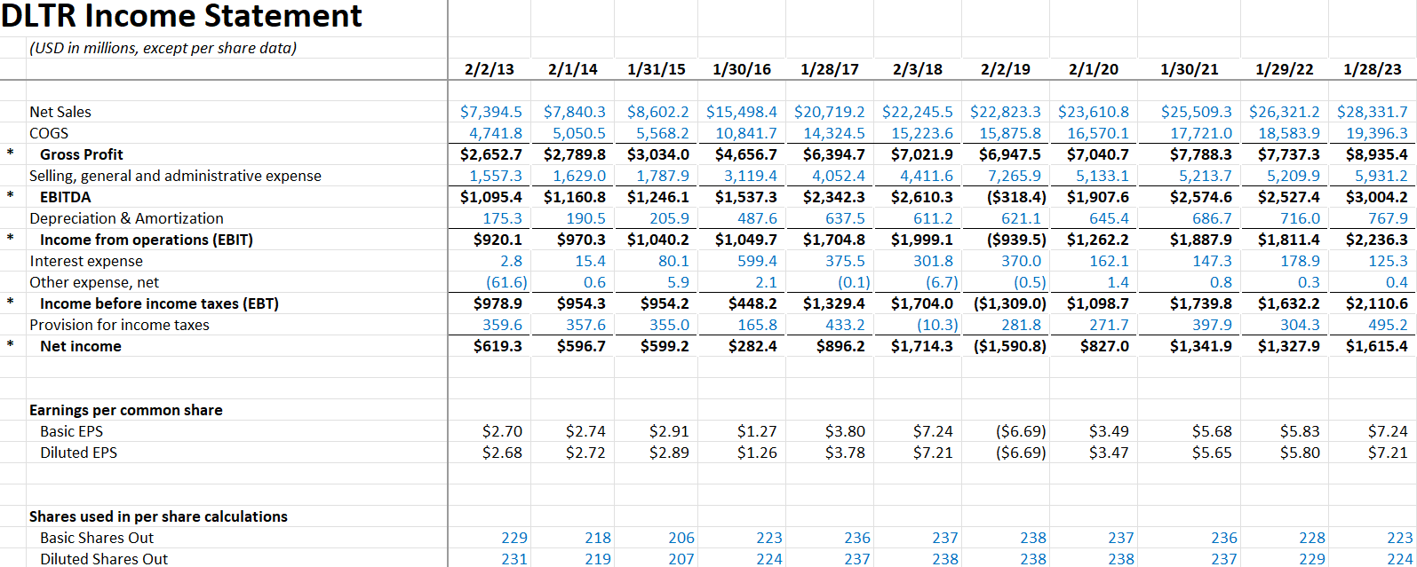
Appendix B: Income Statement
Pluto is a dwarf planet
Dollar Tree

Slide 30
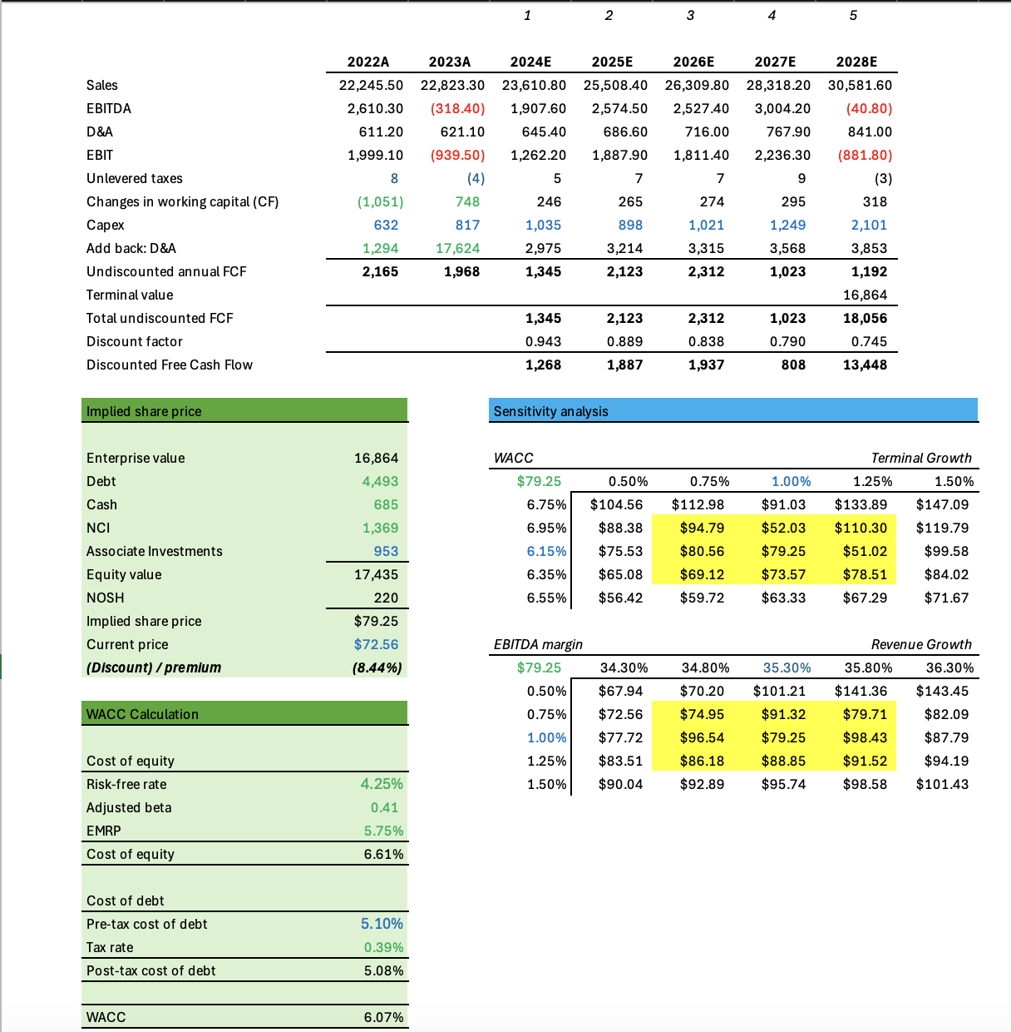
Appendix C: DCF
Dollar Tree

Slide 31
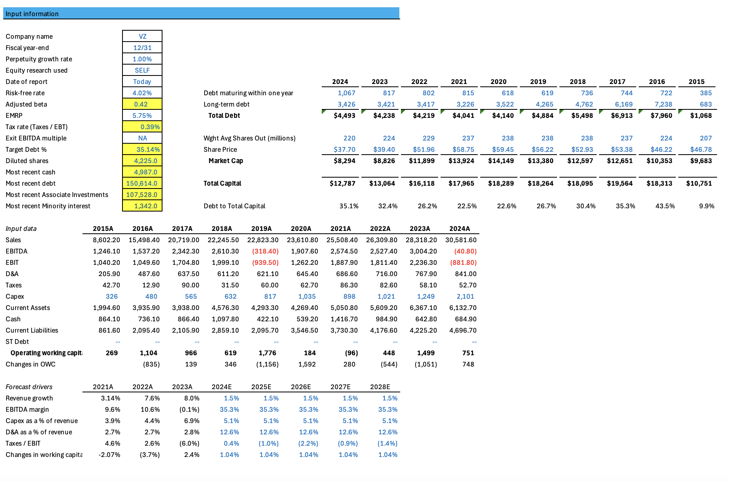
Appendix C: DCF (continued)
Pluto is a dwarf planet
Dollar Tree

Slide 32
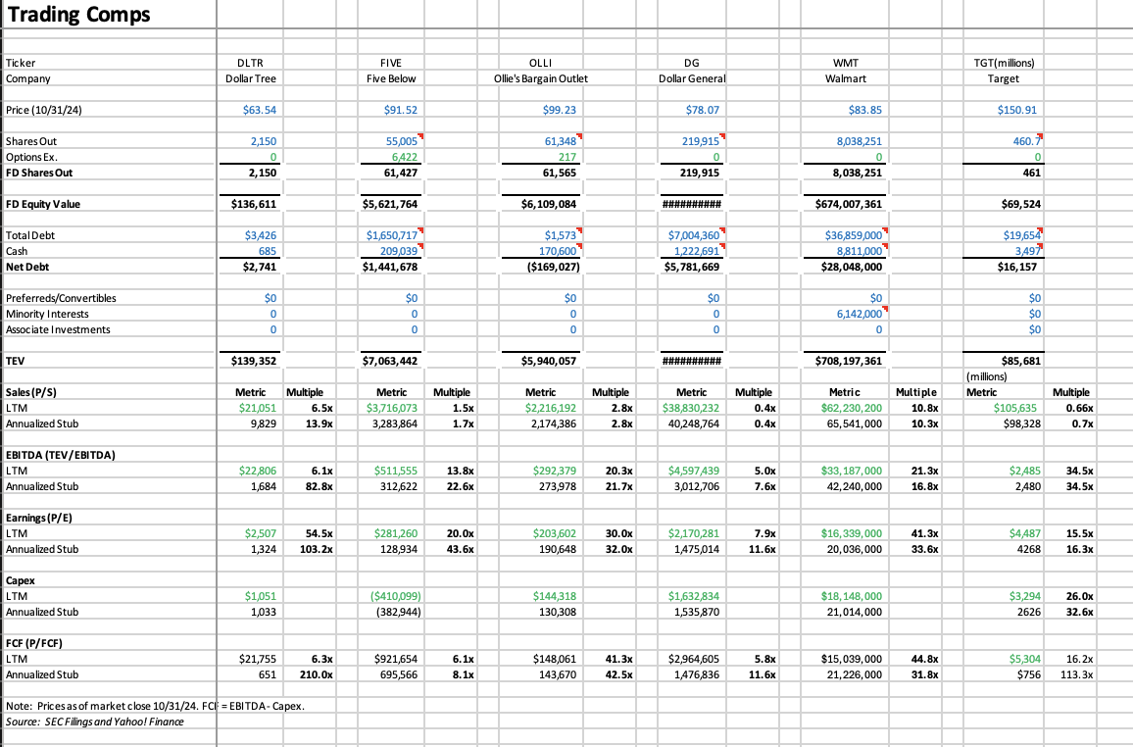
Appendix D: Trading Comparable
Pluto is a dwarf planet
Dollar Tree

Slide 33
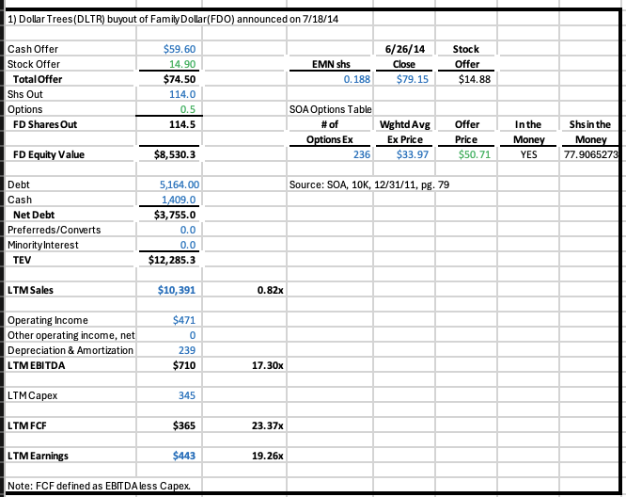
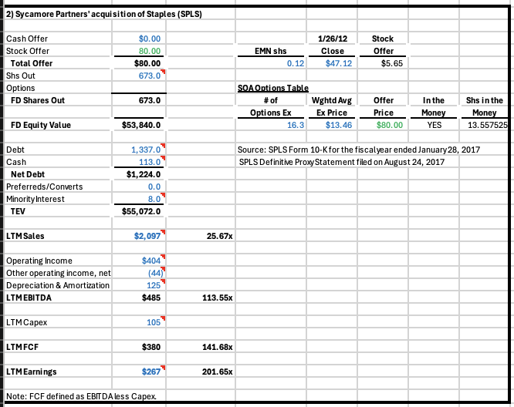
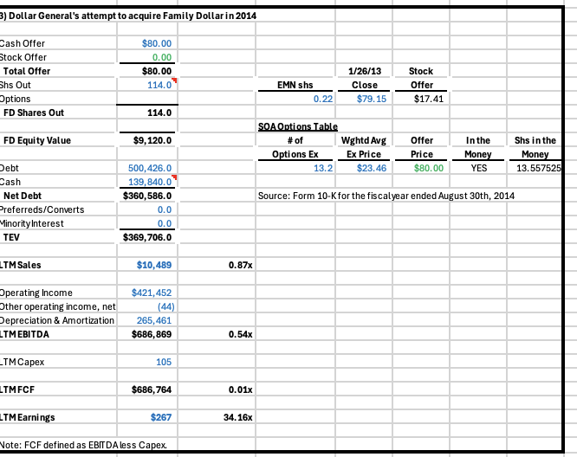
Appendix E: Trading Comparable
Pluto is a dwarf planet
Dollar Tree

Slide 34
Appendix I: Sources
Dollar Tree. (n.d.). Our history. Dollar Tree, Inc. Retrieved December 5, 2024, from https://corporate.dollartree.com/about/our-history
Thomas, B. (2024b). Dollar & Variety Stores in the US. Retrieved from https://my-ibisworld com.proxy.libraries.rutgers.edu/us/en/industry/45299/at-a-glance
Yahoo Finance. (n.d.). Dollar Tree (DLTR) gains on strategic actions: Time to hold? Yahoo Finance. Retrieved December 5, 2024, from from https://finance.yahoo.com/news/dollar-tree-dltr-gains-strategic-154200328.html
Yahoo Finance. (n.d.). Here's why Dollar Tree (DLTR) is a great momentum stock to buy. Yahoo Finance. Retrieved December 5, 2024, from https://finance.yahoo.com/news/heres-why-dollar-tree-dltr-153603708.html
The Wall Street Journal. (n.d.). Dollar Tree cuts annual outlook. The Wall Street Journal. Retrieved December 5, 2024, from https://www.wsj.com/articles/dollar-tree-cuts-annual-outlook-11574774744
DLTR. Nasdaq. (n.d.). https://www.nasdaq.com/market-activity/stocks/dltr
AlphaStreet. (2024, November 22). Dollar Tree (DLTR): Key points of note from the Q3 2024 earnings report. AlphaStreet. https://news.alphastreet.com/dollar-tree-dltr-key-points-of-note-from-the-q3-2024-earnings-report/
Nasdaq. (n.d.). Dollar Tree Inc. Common Stock (DLTR) Earnings Report Date. Nasdaq. https://www.nasdaq.com/market-activity/stocks/dltr/earnings
Author's Last Name, First Initial. (2024, September 4). Dollar Tree (DLTR) earnings Q2 2024. CNBC. https://www.cnbc.com/2024/09/04/dollar-tree-dltr-earnings-q2-2024.html
Pluto is a dwarf planet
Dollar Tree

